Slide 1


REPUBLIC OF CAMEROON
Peace-Work-Fatherland
REPUBLIQUE DU CAMEROON
Paix-Travail- Patrie
AFRICAN INSTITUTE OF COMPUTER SCIENCES - CAMEROON PAUL BIYA TECHNOLOGICAL CENTER OF EXCELLENCE
P.O. Box: 13719 Yaoundé
Tel: +237.242.729.957 Fax: 22729958
E-mail:contact@iaicameroun.com
One Love, One Mind, One Legacy! LinkedIn: Shaderl Tel: (237) 678 358 509 / (237) 692 199 722 Site Web: www.shardel.com
DESIGN AND IMPLEMENTATION OF A DIGITAL PLATFORM FOR INSTITUTIONAL ENGAGEMENT AND STUDENT ATTENDANCE
Internship carried out from the 1st of July to the 30th of September 2026 at the company Shaderl as part of my pursuit to obtain an
Engineering Diploma in Computer Science
Option: Software Engineering
Submitted by:
MOMO CLIFF
Level III Student at AICS Cameroon
SUPERVISORS
Academic Supervisor
Professional Supervisor :
Mme Claudia Nzali
Academic year
2025-2026
Mr Emate Yvann

Slide 2

01
Introduction
02
Context and problematic
03
Proposed solution
04
Methodology
05
DEMOSTRATION
06
Conclusion

Slide 3
01
introduction

Slide 4

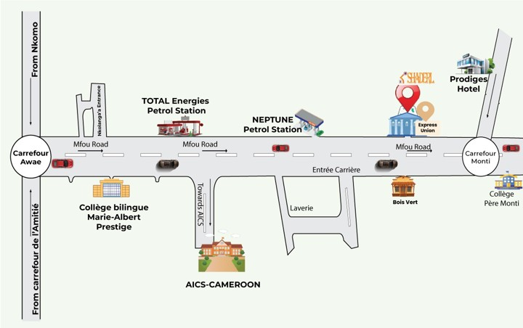
2023
Mr ASANE DERICK
01
Part 01
Part 03
2023
Mr ASANE DERICK
Part 02

Slide 5


2023
Mr ASANE DERICK
01
Part 01
Part 03
Part 02

Slide 6
01
Part 01
Part 03
Shaderl Stock
Part 02
Shaderl Algo
Notes:
NOW LET MOVE DIRECTLY TO OUR CONTEXT

Slide 7
03
Context And Problematic

Slide 8
CONTEXT
1

Slide 9


03
CONTEXT
Notes:
NOW

Slide 10
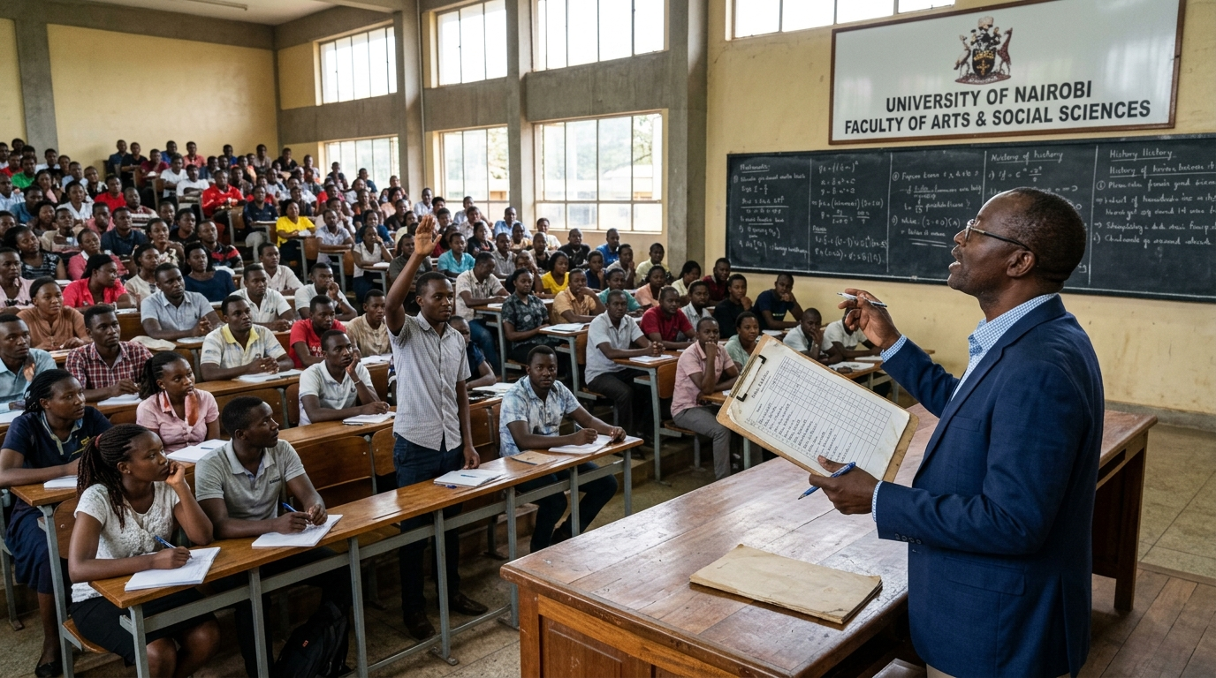
03
CONTEXT

Slide 11
03
CONTEXT

Slide 12

“How can we improve the communication, attendance management, within an educational institution through a reliable and centralized digital environment?”
1
Notes:
we can still find several important activities being handled manually or through informal communication channels.
For example, information can be communicated through different channels, attendance can be recorded on paper, and academic marks can also be managed using paper-based records or separate tools.
To understand the need for our solution, let us first look at how some of these activities are currently handled

Slide 13
03
PROPOSE SOLUTION

Slide 14

CAMPUSLY
1
Notes:
we can still find several important activities being handled manually or through informal communication channels.
For example, information can be communicated through different channels, attendance can be recorded on paper, and academic marks can also be managed using paper-based records or separate tools.

Slide 15
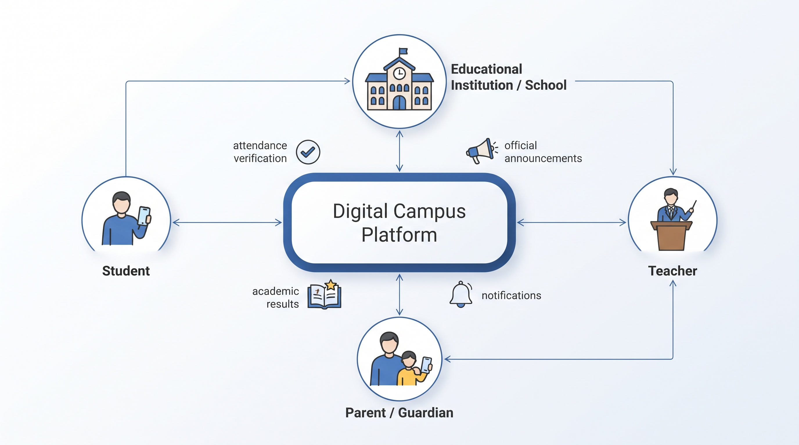
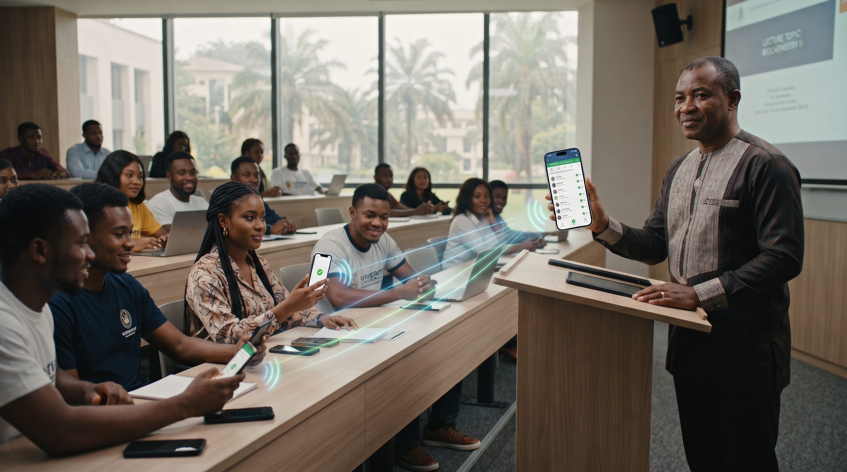
03
CAMPUSLY
Notes:
IT IS A DIGITAL PLATFORL THAT LINKS INSTITUTION WITH PARENTS, STUDENTS AND OUT SIDERS IN ONE CENTRALIZED ENVIRONEMENT

Slide 16
03
CAMPUSLY
Notes:
IT IS A DIGITAL PLATFORL THAT LINKS INSTITUTION WITH PARENTS, STUDENTS AND OUT SIDERS IN ONE CENTRALIZED ENVIRONEMENT

Slide 17

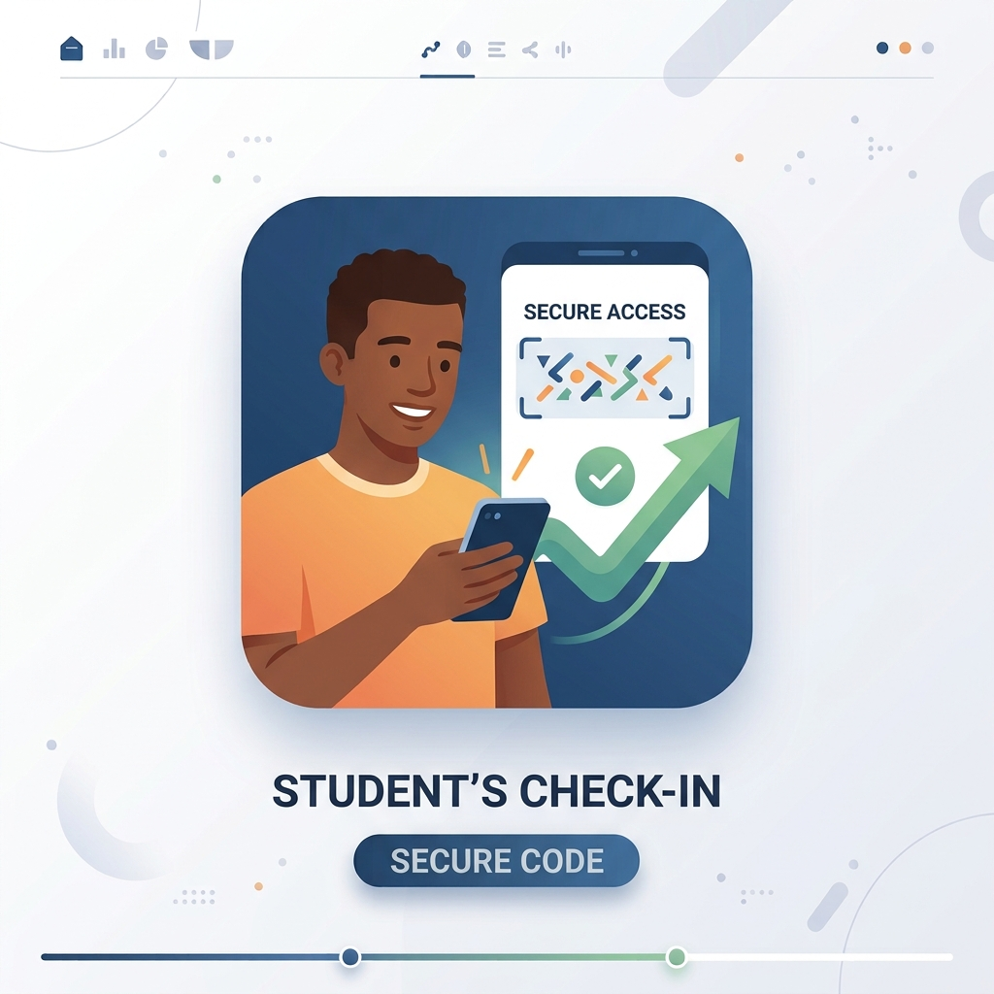
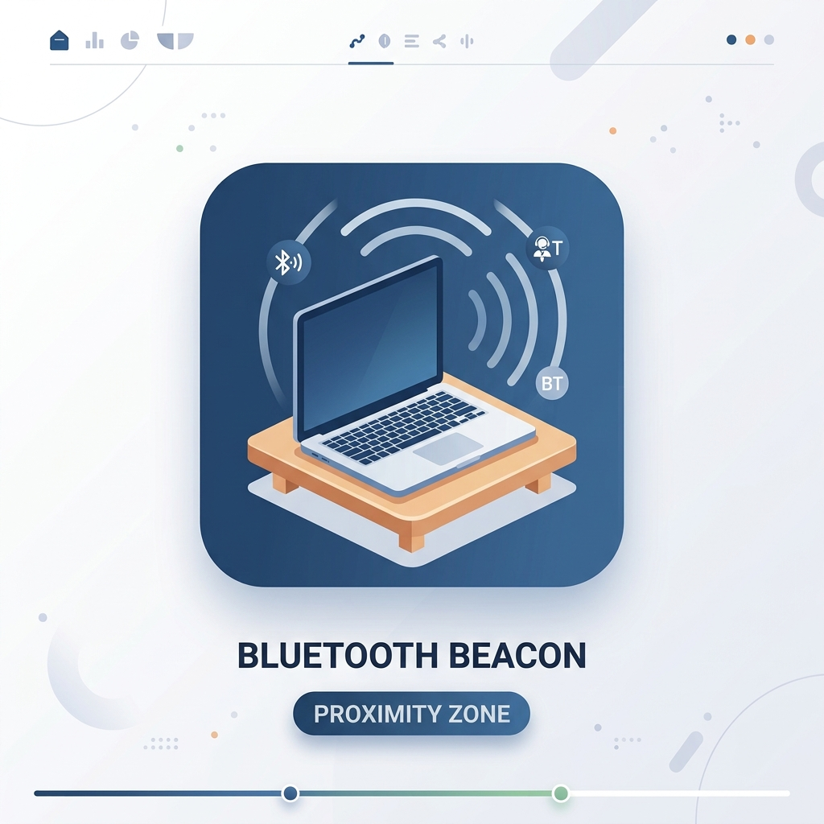
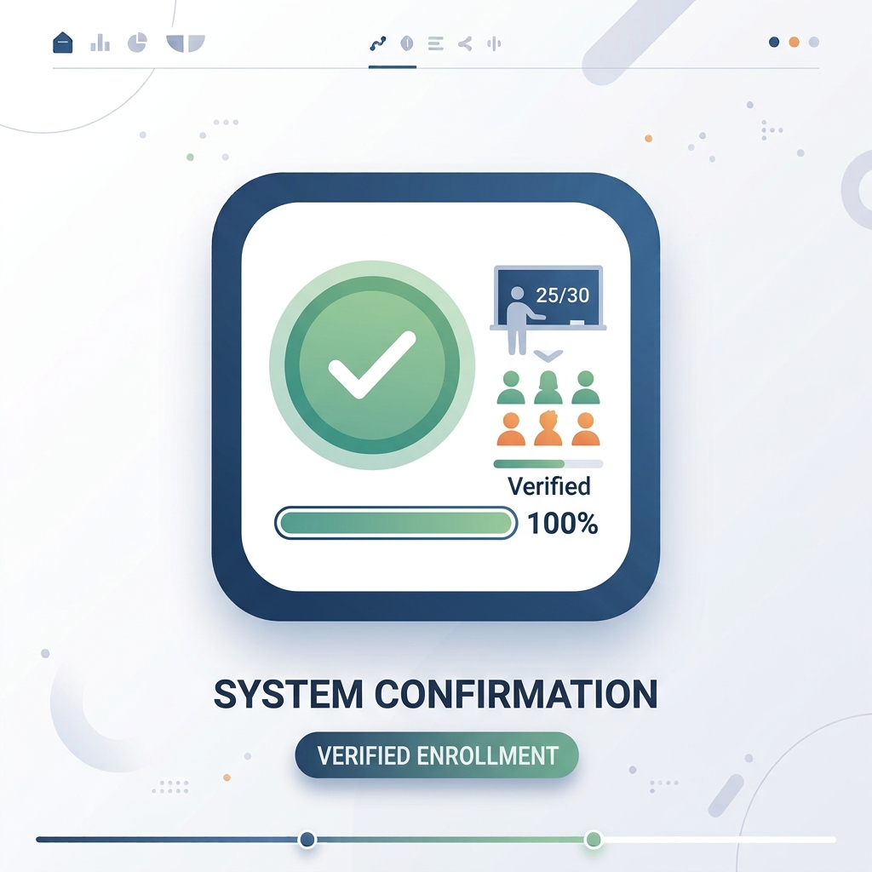
03
CAMPUSLY
1
3
2
4

Slide 18
04
METHODOLOGY

Slide 19
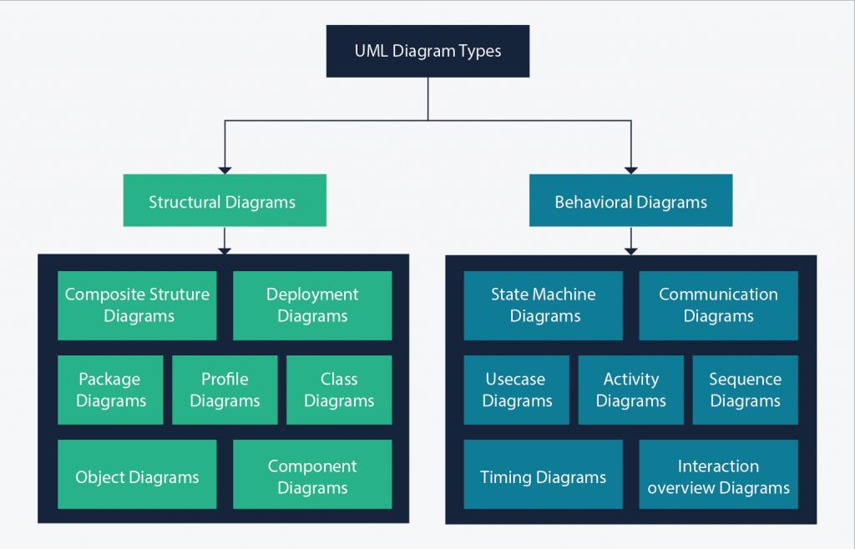
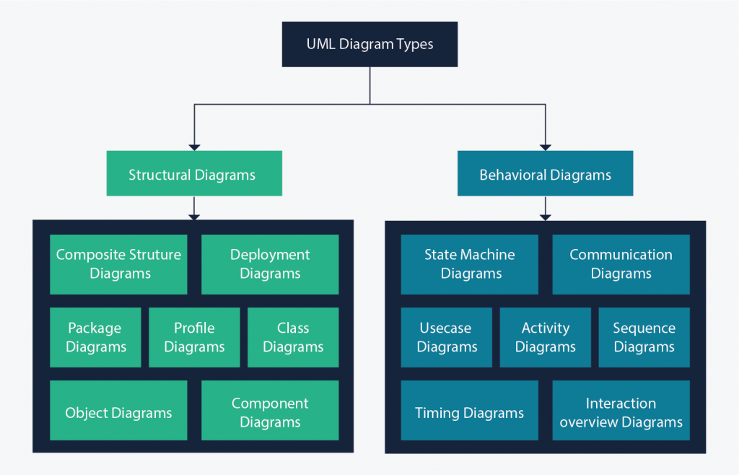

04
UML(Unified Modeling Language)
Version 2.5
UML (unified Modeling Language) is a standardized modeling language used to implement a system in the form of diagrams

Slide 20
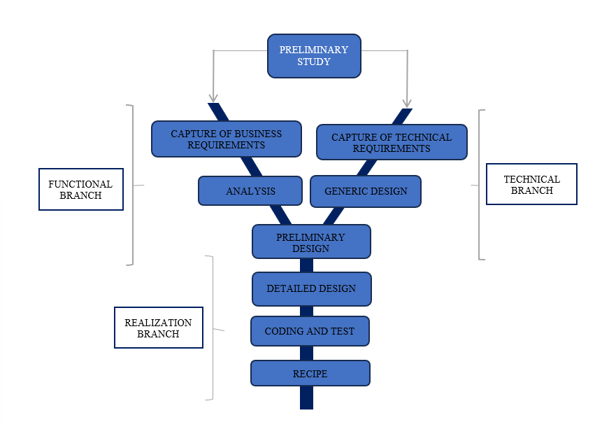
04
2tup
It's an adaptation of the Unified Process (UP) used in software development for system analysis and activity designing.

Slide 21
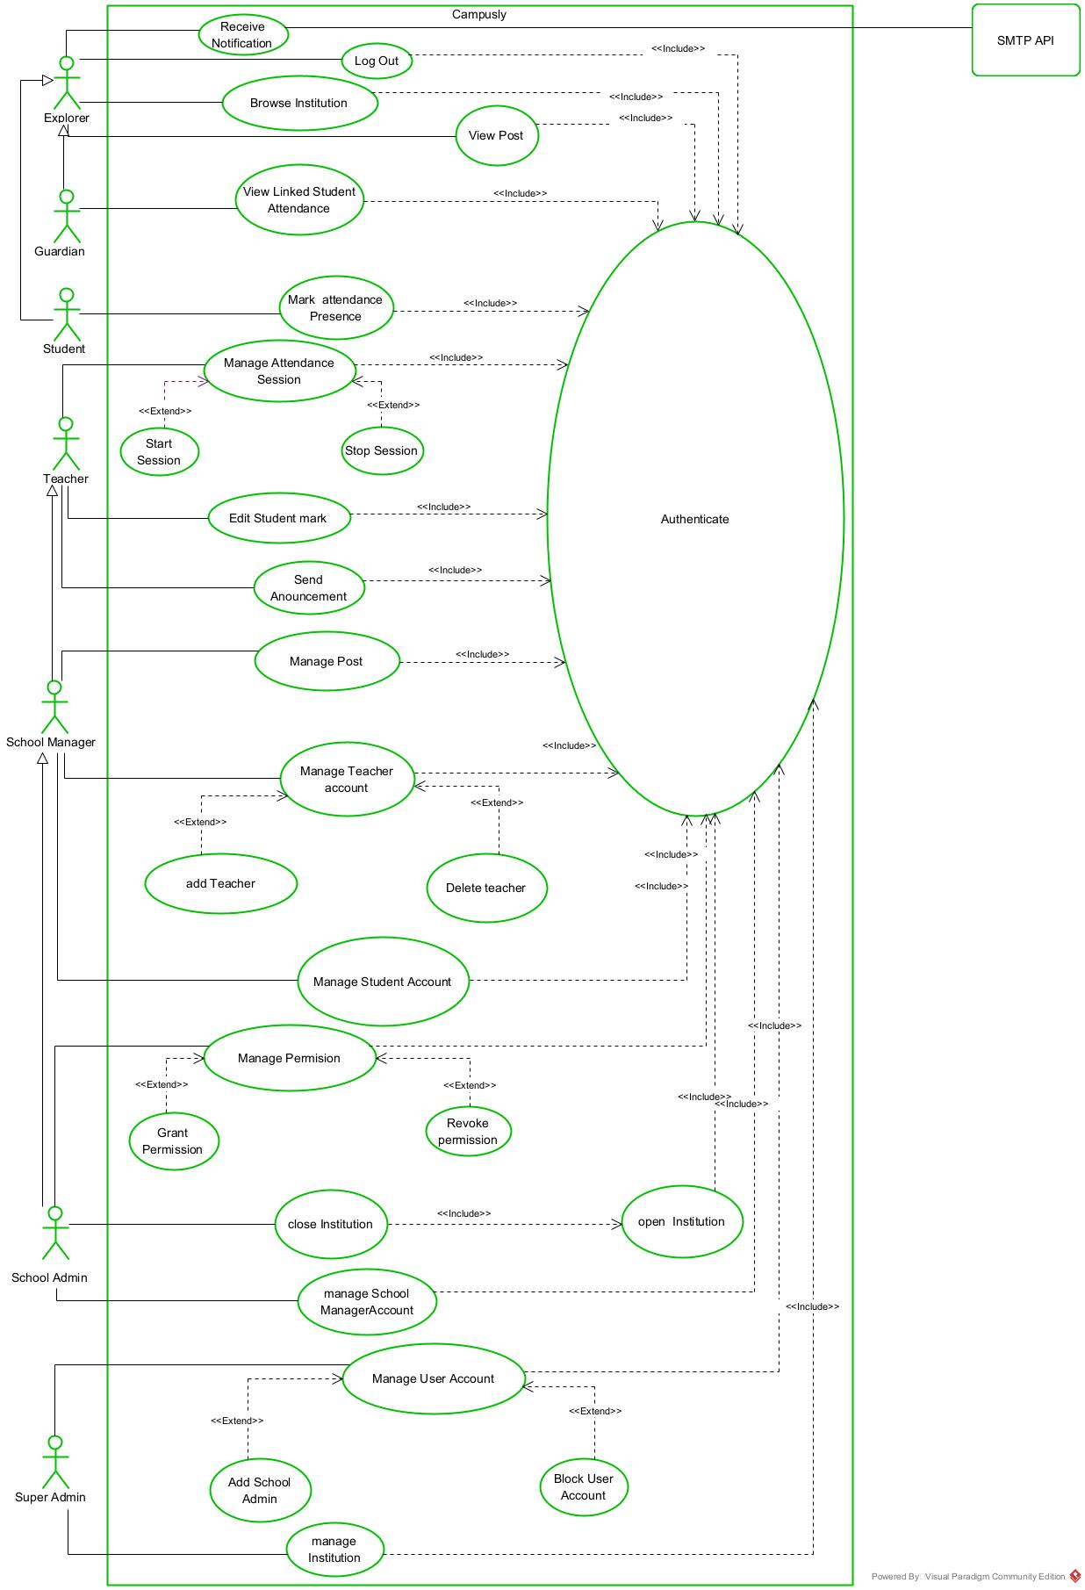
04
General use case diagram
A use case Diagram is a graphical representation of the functional requirements of a system

Slide 22
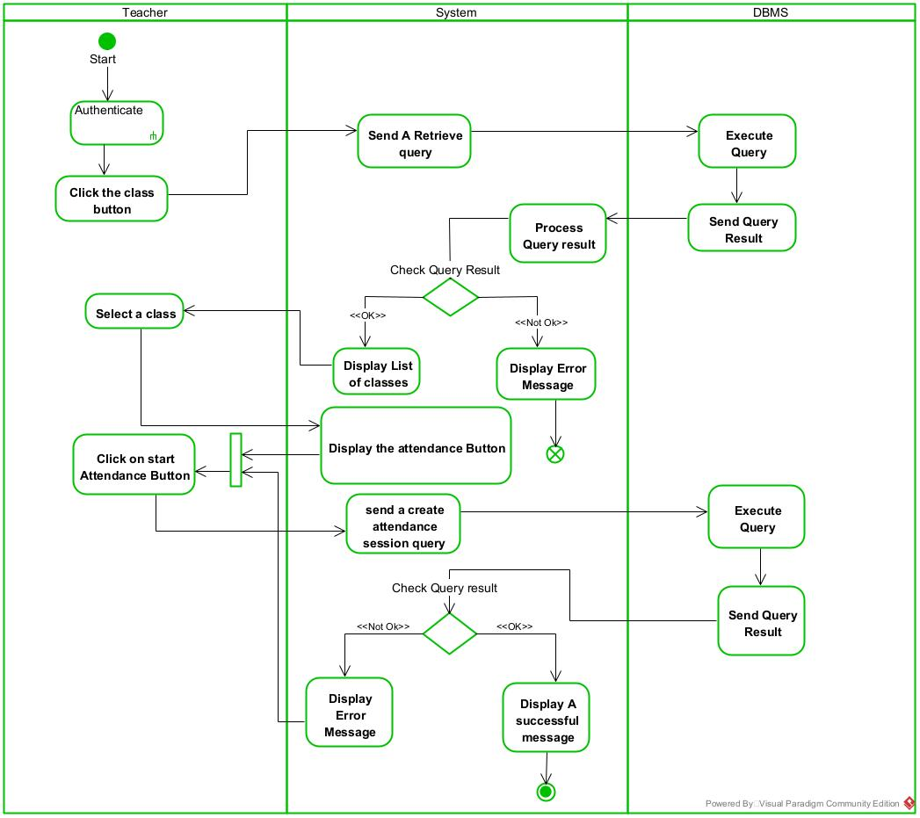
04
Start Attendance activity
An activity diagram is a behavioral diagram in UML that shows the dynamic aspects of a system, modeling the flow of activities, actions, and decisions.

Slide 23
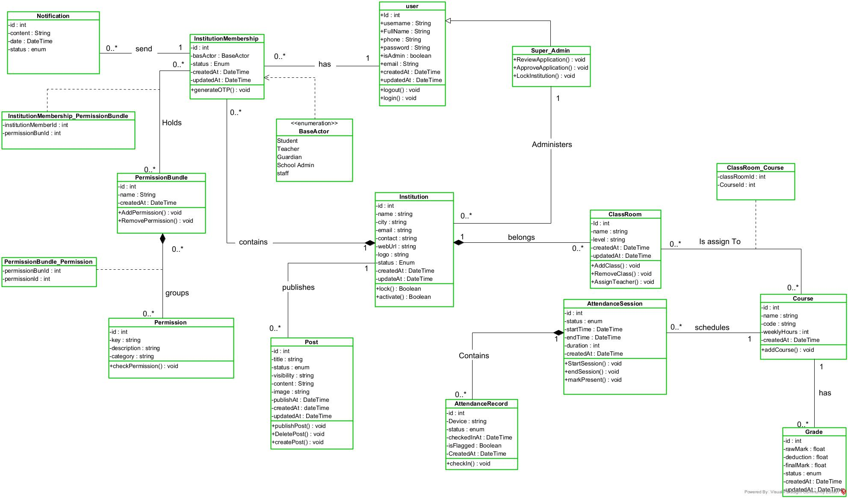
04
Class Diagram

Slide 24
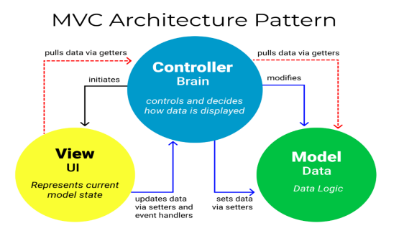
04
Architecture
LOGICAL ARCHITECTURE

Slide 25
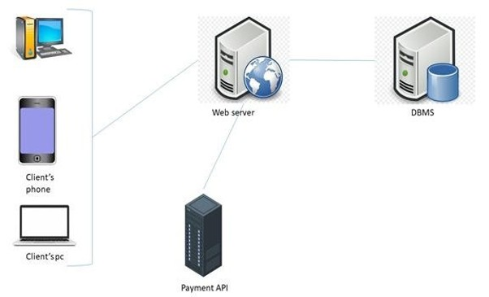
04
Architecture
physical ARCHITECTURE
SMTP

Slide 26





04
Tools use
Next.js
PRISMA
React Native
NestJS
POSTGRESSQL

Slide 27
05
DEMONSTRATION

Slide 28
06
CONCLUSION

